Slide 1
Financial Aid 101

Slide 2
What is Financial Aid?
Funding for students and families to help pay for postsecondary education and related expenses.
Put simply: Money used to pay for college

Slide 3
Financial Aid is NOT…
Credit Cards
Shopping
Buying a Car
Partying
Spring Break/Vacation

Slide 4
Cost of Attendance
Direct Costs
Paid DIRECTLY to the University (billed twice per year):
Tuition & Fees
Room & Board
Indirect Costs
Paid to others and can include:
Books & Supplies
Personal & Miscellaneous Items
Transportation

Slide 5
U-M: Cost Of Attendance
 | In-State | Out-of-State
Tuition & Fees | $15,262 | $49,350
Room & Board | $11,534 | $11,534
Books & Supplies | $ 1,048 | $ 1,048
Personal/Misc. | $ 2,454 | $ 2,454
TOTAL | $30,298* | $64,386*
* This is the maximum amount of financial aid you can receive.

Slide 6
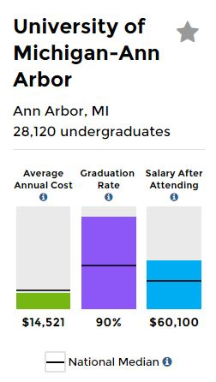
Compare Colleges & Affordability
Planning Tools: finaid.umich.edu/comparecollege
College Scorecard: collegescorecard.ed.gov compares colleges from around country

Slide 7
What is your cost?
Net Price Calculator
A free, interactive tool that provides estimated net cost
Uses institutional data
Calculates individual situations
Check each school’s Financial Aid website
FAFSA4caster
Free federal tool
Early estimate for federal student aid
Offers options to pay for college

Slide 8
Eligibility: Expected Family Contribution
Calculated using a federal formula with information from the FAFSA
Parent contribution & student contribution
Amount a family can reasonably expect to contribute
The same at every institution
EFC

Slide 9
Eligibility: Calculating Financial Need
 | Cost of Attendance (Budget)
− | Expected Family Contribution (EFC)
− | Other Aid or Resources (such as private scholarships)
= | Your Need for Aid
 | $26,000
− | $ 4,000
− | 0
= | $22,000

Slide 10
Types of Aid: FREE Money
Scholarships
Earned in some way– grades, skills, service, etc.
Awarded by a variety of organizations
May, or may not, require FAFSA and/or other applications
Grants
Need-based award
Must complete FAFSA to apply
May need to complete other applications such as CSS PROFILE or other institutional forms

Slide 11
Types of Aid: Scholarships Scams
Watch for:
Scholarships with application fee
No contact telephone number
Unsolicited scholarship opportunity
Hype or pressure to participate
Scholarship services who guarantee success
Social Security number, checking/savings account info
MORE INFORMATION: studentaid.ed.gov/sa/types/scams

Slide 12
Types of Aid: Understand Your Scholarship
One-time vs. Renewable
If renewable, are there requirements?
GPA
Major Specific
Full Time
Tuition-Specific Scholarship
What’s the value of the scholarship?
Full ride vs. partial (will you have remaining costs?)

Slide 13
Types of Aid: EARNED Money
Work-Study allows you to:
Get paid for your work
Receive bi-monthly paychecks
Have flexible work schedules
Consider on- or off-campus opportunities
Students not awarded Work-Study with their financial aid award may apply for other jobs on campus and off

Slide 14
Borrowed Money
Loans
Borrow only what is REALLY needed
Repayment begins after graduation
Federal Loans from the FAFSA
Subsidized Direct Loans - student is borrower, interest does not accrue until repayment
Unsubsidized Direct Loans - student is borrower, interest accrues as loan begins

Slide 15
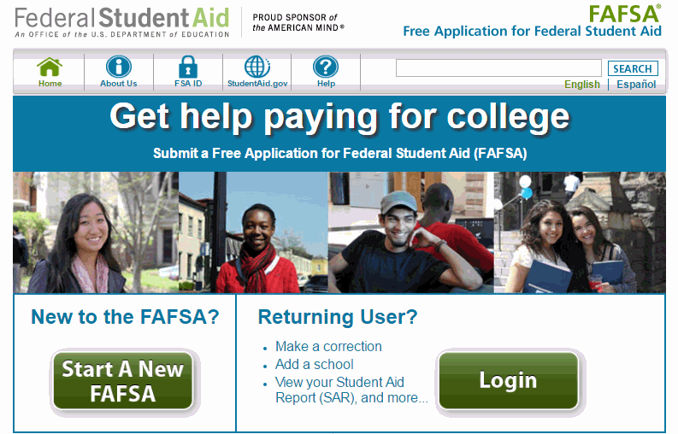
Completing the FAFSA
It’s free, easy, fast and more people qualify for student aid than you think.

Slide 16
Completing the FAFSA: What Should I Expect?
Three of four sections are student information
One section is for parents or legal adoptive parent
“As of today” language
Males must register with the Selective Service www.sss.gov

Slide 17
Completing the FAFSA: Who?
Each student
Parental data can be transferred for multiple children
Parent(s)
Both parents (biological, step-parent, adoptive) if married
Only one parent if single, divorced or separated (the one the student lives with)
If both parents live in the same house and are not married both incomes go on FAFSA

Slide 18
Dependent vs. Independent
Dependent (most students are dependent)
Requires parental information
Independent (No parental information required if):
Married
At least 24 years old
At any time since you turned age 13, were both your parents deceased, were you in foster care, or Ward of the Court/State
Have a dependent that you provide more than 50% support for
Homeless
(This is a sample of questions on the FAFSA that determine independent student status)

Slide 19
Completing the FAFSA: Why?
Expected Family Contribution (EFC) determines your aid eligibility
Single application for multiple sources of aid
Can list up to 10 schools on your application

Slide 20
Completing the FAFSA: When?
The FAFSA is available on October 1 using earlier tax information
State of Michigan deadline is March 1
Check with your school for more specific deadlines
FAFSA is an annual application. File it every year!

Slide 21
Completing the FAFSA: How?
IRS Data Retrieval (preferred) or 2017 Tax Return
Bank/Asset Statements
Child support (Paid or received)
Other untaxed income received except social security

Slide 22
Completing the FAFSA: FSAID
FSAID
Student AND One Parent
fsaid.ed.gov
Allows student and parent to sign FAFSA electronically
Each needs individual FSAID

Slide 23
Completing the FAFSA: Frequent Errors
Social Security numbers
Divorced/remarried parental information
Student/parent income
Untaxed income
Real estate & investment net worth
U.S. income taxes paid
Household size
Number of household members in college
Work-Study preferences

Slide 24
Completing the FAFSA: What’s Next?
Make necessary FAFSA corrections
Complete institutional forms
CSS Financial Aid PROFILE
Scholarship Applications
Verification
Additional documentation (Federal Tax Transcripts, W-2s)
Estimated Aid Awards will be sent in early 2019
Not binding, simply an offer

Slide 25
Completing the FAFSA: Special Circumstances
Change in employment, death, marital status, one-time significant benefit, large out of pocket medical expenses, etc.
Cannot report on FAFSA
Send explanation to each financial aid office
All special circumstances will be reviewed and a FINAL decision will be made
Cannot appeal this decision to Department of ED

Slide 26
Next Steps for Students & Families
Consider payment plans
Know before you go
Satisfactory Academic Progress
Apply for scholarships every year
Meet all Deadlines
Check & Respond to your EMAIL
Check & respond promptly to request
Problems/Issues
Talk to the experts on campus

Slide 27
Thank you!
Antonio Junior-Robins
Senior Financial Aid Administrator
juniorra@umich.edu | 734-763-4124
OFFICE OF FINANCIAL AID
515 E. Jefferson St.
Ann Arbor, MI 48109-1316
finaid.umich.edu

